Slide 1
What is Apache DolphinScheduler?
-- new generation workflow scheduler platform
Tianqi

Slide 2
CONTENTS
01
02
Introduction
Pain Points
03
04
Community
Advantages
05
06
Architecture Iteration
Use Cases
07
08
Future Roadmap
Related Resource

Slide 3


PART 1
DolphinScheduler Introduction

Slide 4

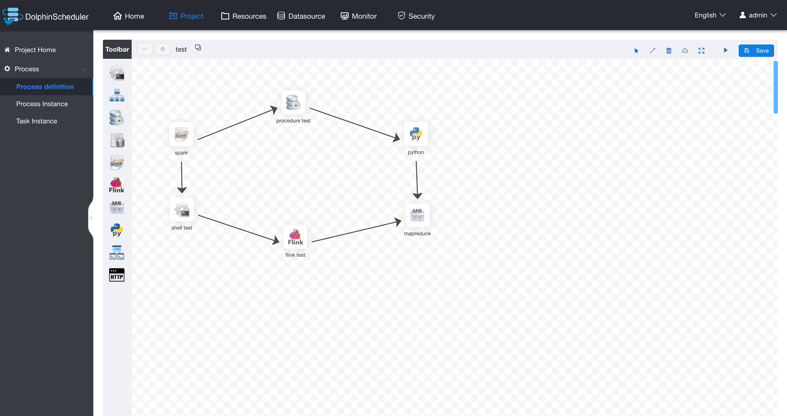
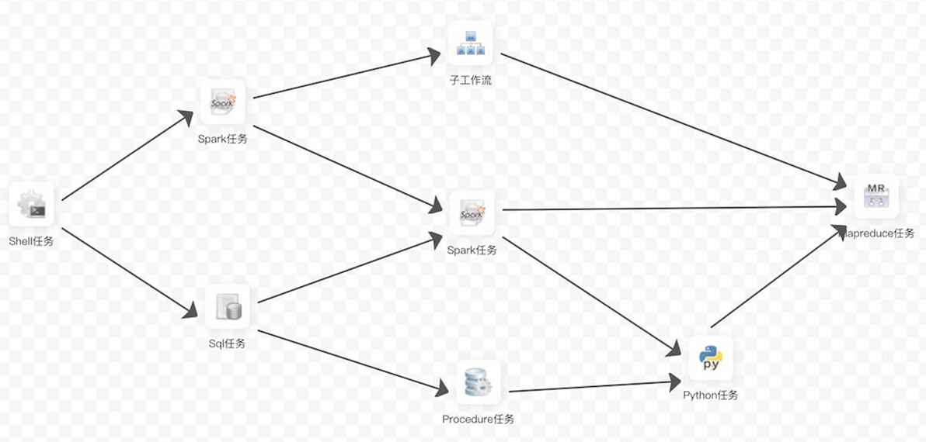
Apache DolphinScheduler Introduction
1、Established at Analysys Inc. in 2017.
2、Open source in March 2019 and joined Apache incubator in August 2019.
3、DolphinScheduler is a distributed and extensible workflow scheduler platform with powerful DAG visual interfaces, dedicated to solving complex job dependencies in the data pipeline and providing various types of jobs available `out of the box`.

Slide 5


PART 2
Pain Points

Slide 6

Pain points – Why do we do this
01
Visual DAG
04
Dependency
simple and easy to operate
view task status in real time
visual task log
self-dependent task
workflow dependency, etc.
02
High availability
05
Alert/Log mechanism
fault-tolerance
failure retry, rollback & transfer
Easy-maintenance
alert warnings via mail/sms/wechat…
06
Complement
re-fresh historical data
03
Multi task types
cross language
customized task plugins
easy-to-extend

Slide 7
PART 3
Community

Slide 8






















Some User Cases (In No Particular Order)

Slide 9
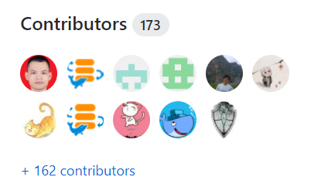

DolphinScheduler Community Overview
“Community Over Code”
Analysys
Byte
Dance
Alibaba
Tencent
JD
DiDi
HUAWEI
Pingan
360
Code Contributors
XiaoMi
MoMo
GuanData
Dmall
LY
10086
FunPlus
LiZhi
Company Contributors Distribution
Document Contributors

Slide 10
PART 4
Advantages
2021/4/14
10

Slide 11




Advantages
High Reliability
Simple and Easy
Decentralized multi-Masters and multi-Workers, supports HA
Using task queues to avoid overload
Fault-tolerant capability
DAG user interfaces
Dataflow definitions are visualized through drag and drop
Open APIs
One-click deployment
Rich Usage Scenarios
High Scalability
Support pause and resume operations
Support multi-tenancy
Support various task types: Shell, MR, Spark, SQL (MySQL, PostgreSQL, hive, spark SQL), Python, Sub_Workflow, Procedure, etc
Support customized task types
Scheduling capacity grows linearly with the cluster nodes
Support dynamic Master and Worker online and offline

Slide 12
Main capabilities
Tasks are associated as DAG form
Real-time monitoring of task status
Supports more than 10 task types such as Shell, MR, Spark, SQL, dependency, etc
Supports workflow priority, task priority
Global parameters and customized parameters
Supports workflow scheduling, dependent, manual impacts, and pause/stop/resume
Supports complement, multi-tenancy, online log viewing and resource online management
Complete system monitoring, task timeout /failure alert.
The decentralized design ensures the stability and high availability of the system
Supports stable operation of 100,000 volume of data tasks per day

Slide 13
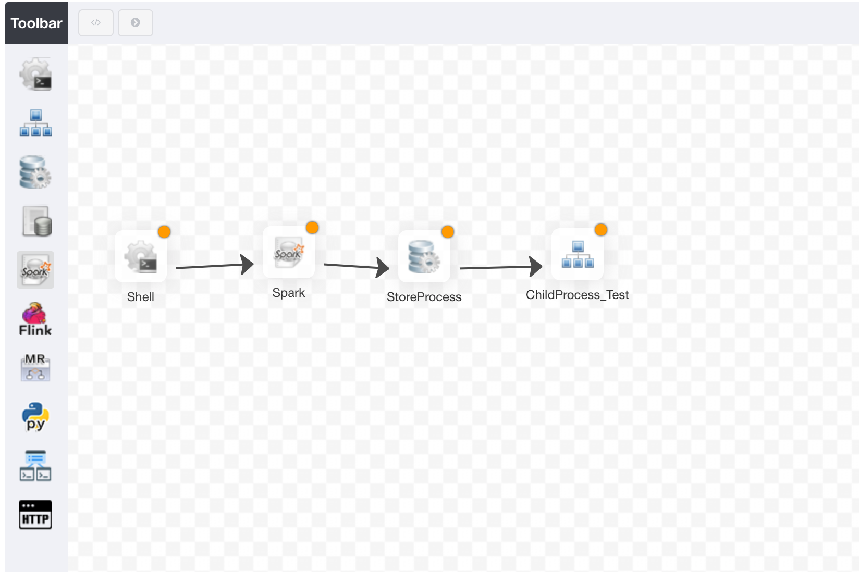
Workflow Management:
Visualized Drag-and-Drop Workflow Configuration
Visualized drag-and-drop optimizes task creation efficiency
Support various task types: Shell, MR, Spark, SQL (MySQL, PostgreSQL, hive, spark SQL), Python, Sub_Process, Procedure, etc
Sub_Process
Sub_Process enables the reuse of data resolve, imports and data persistence, avoid repeated configurations

Slide 14
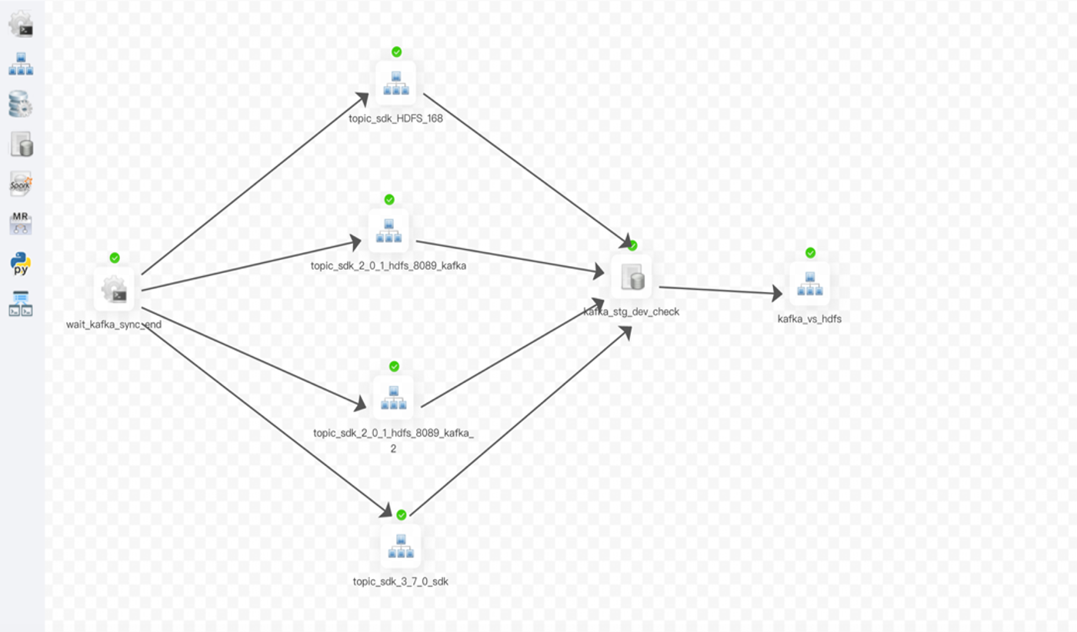
Visualization of Running Workflow

Slide 15
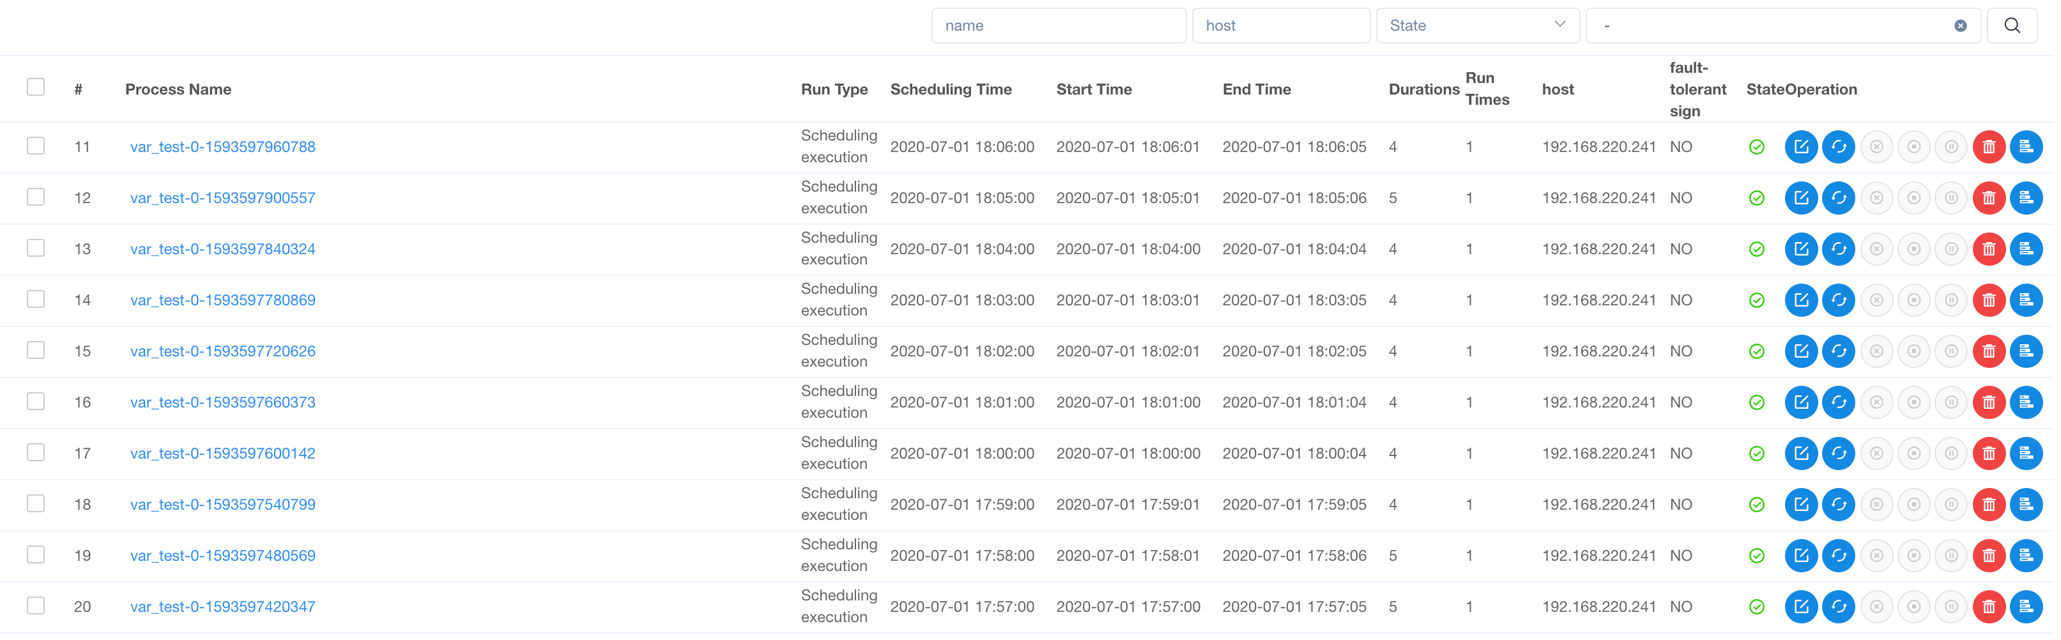
Supports Rerun and Retry Tasks and Inspect Task

Slide 16
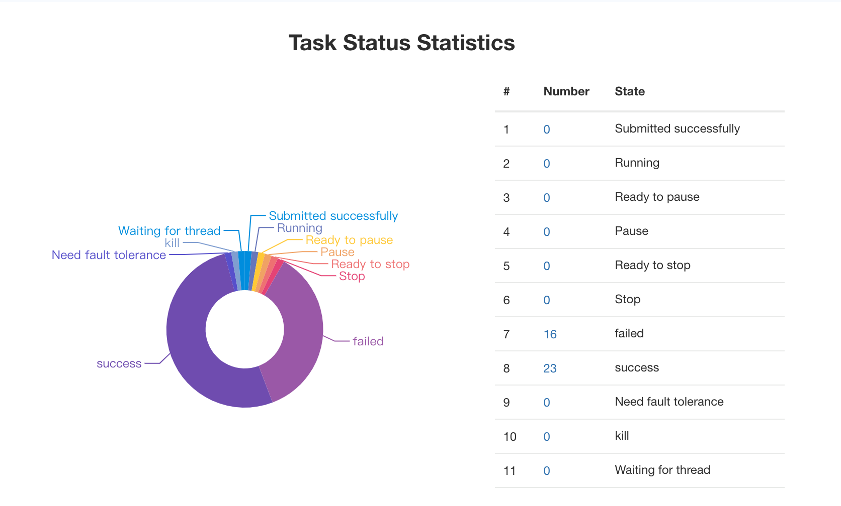
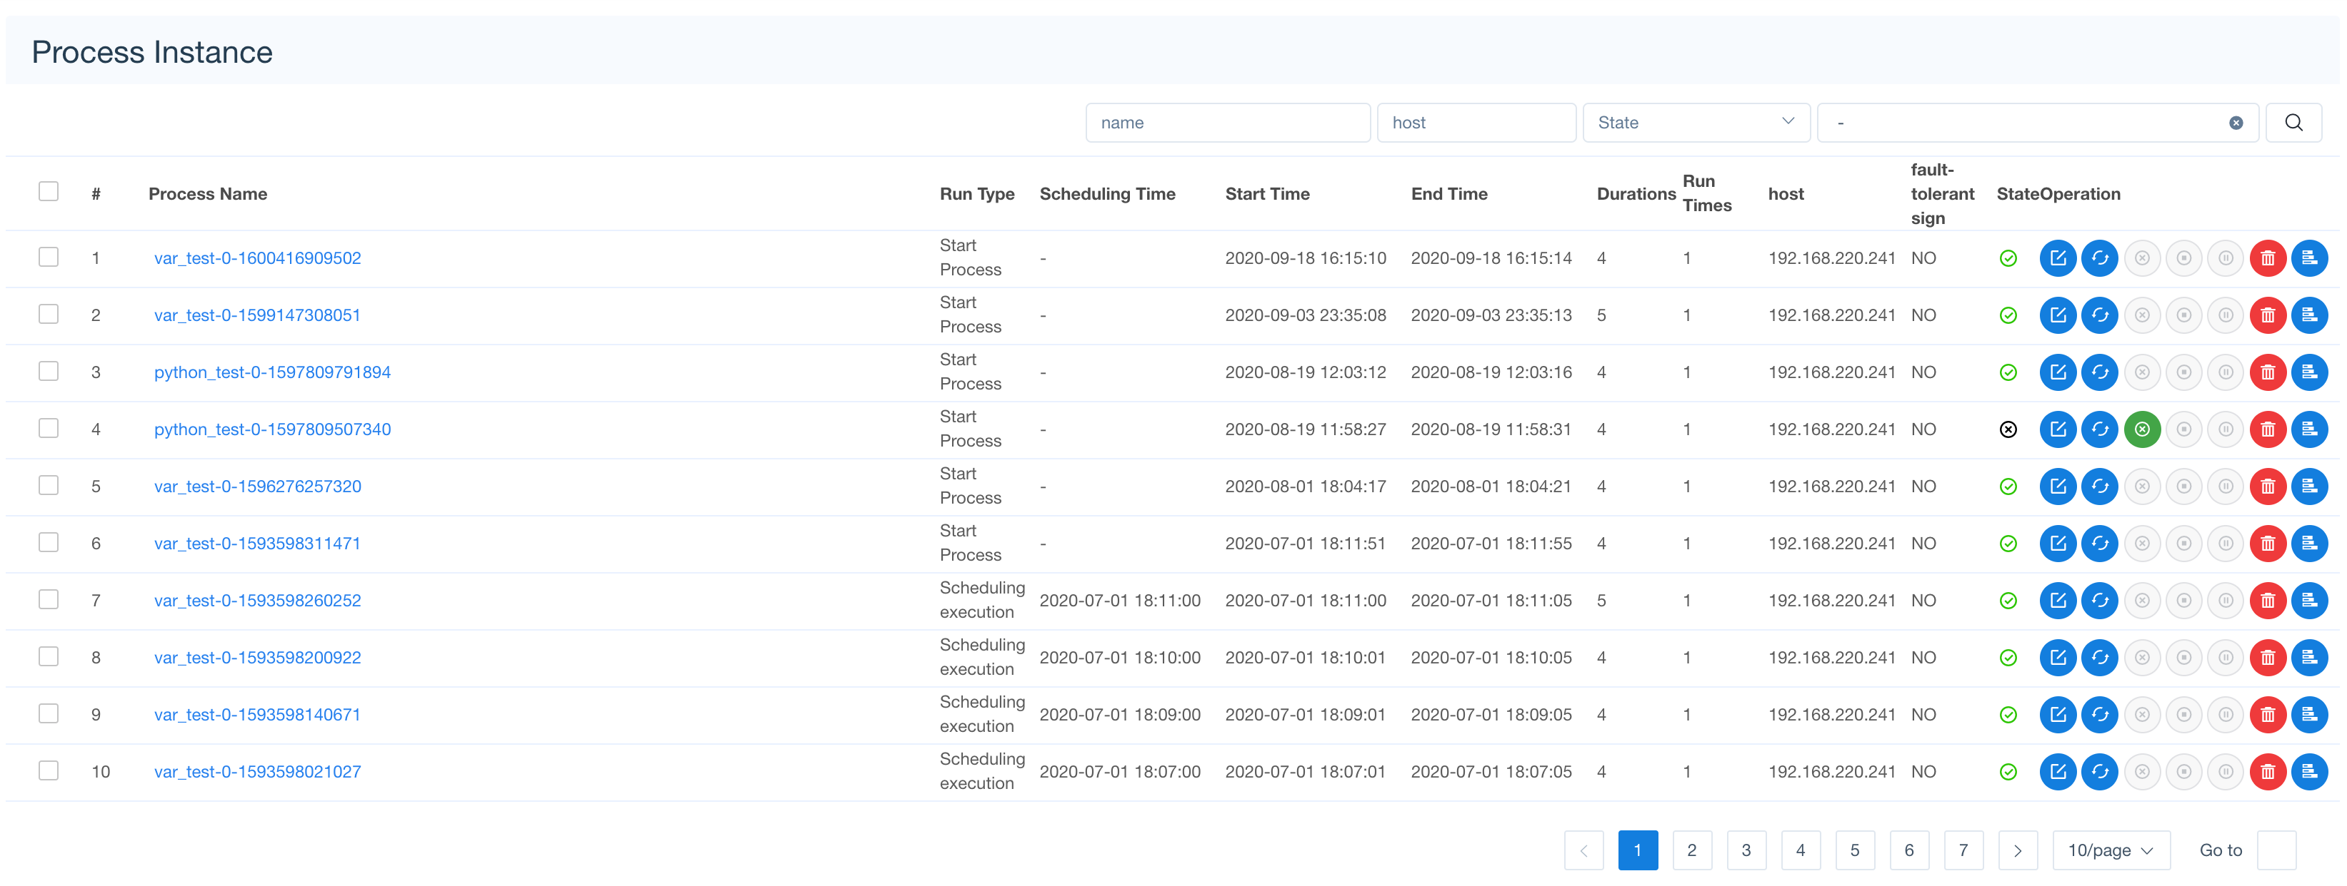
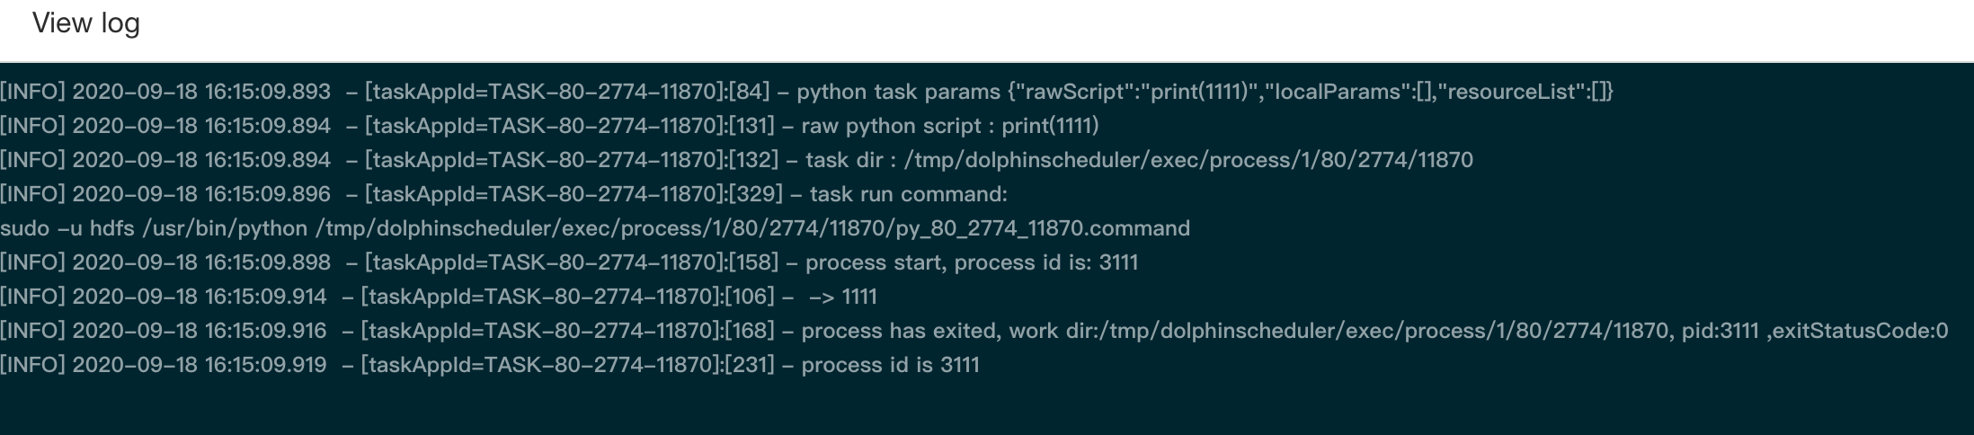
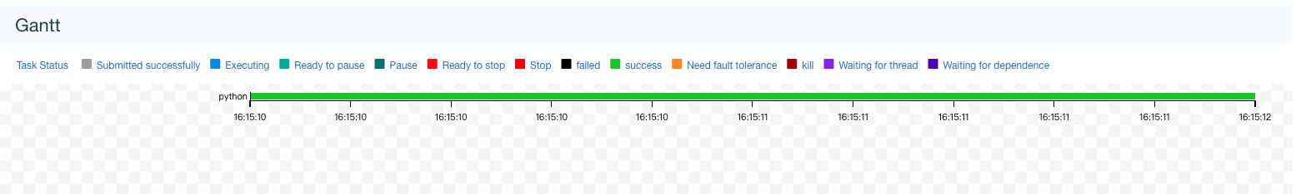
Task Management: Multi-Granularity Monitoring
Task status data statistics
Process instance status view
Tracking of task execution status
Task execution log online

Slide 17
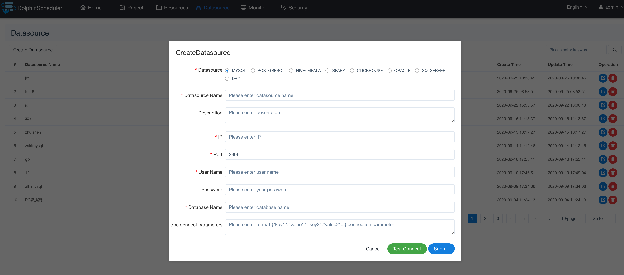
Data-Source Management:
Visualized Configuration and Multiple Data Compatibility
Visualized data-sources include ：MySql、PostgerSql、Hive、Impala、Spark、ClickHouse、Oracle、SqlServer、DB2、MongoDB.
Supports Plugin data-source extension
Visualized data-source management
Configure once, use everywhere.

Slide 18
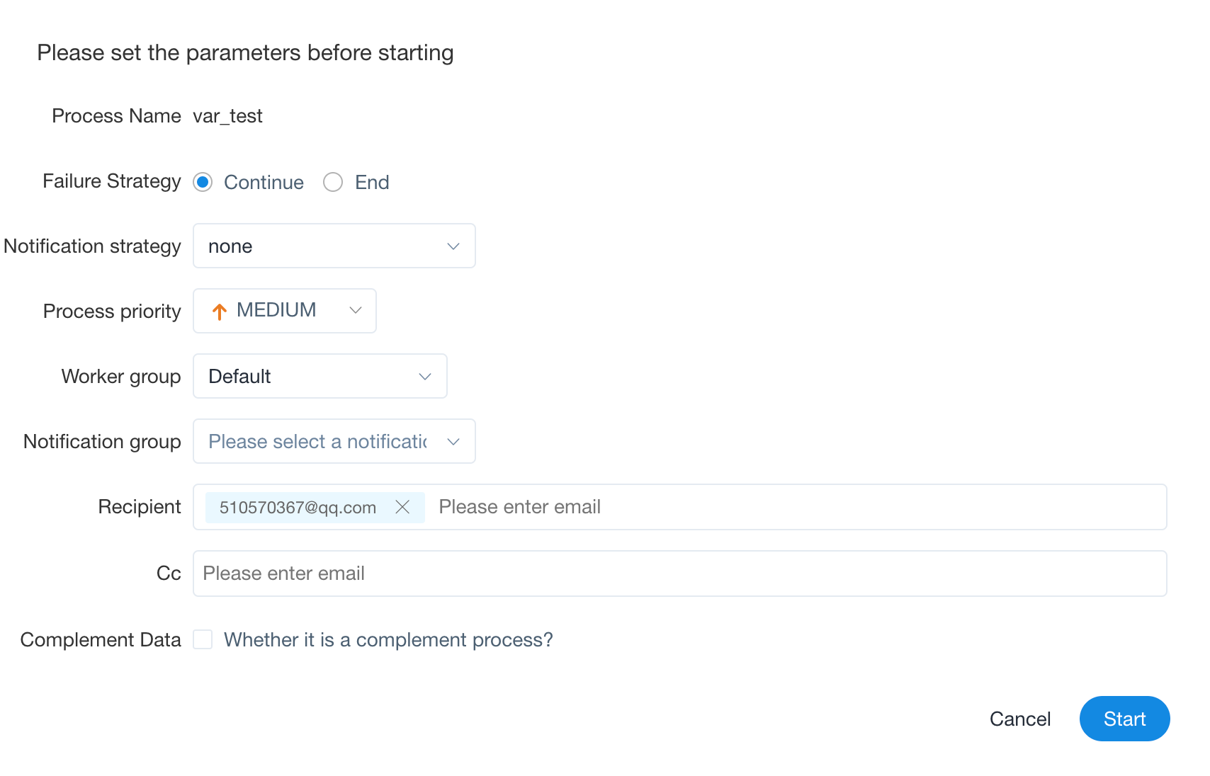
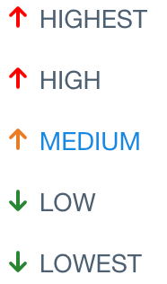
Workflow Startup Management
Task failure strategy:
Continue
End
Multi notification strategies:
Success
Failure
All
None
Workflow Priority
Selected nodes execute ETL workflow
Complement Data
Serial execution
Parallel execution

Slide 19
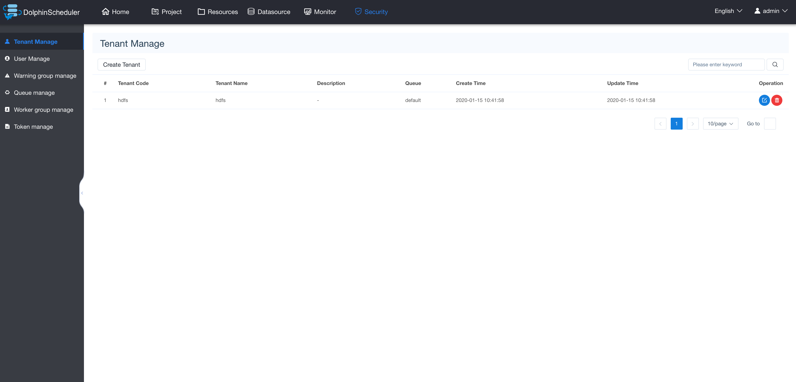
Security Center

Slide 20
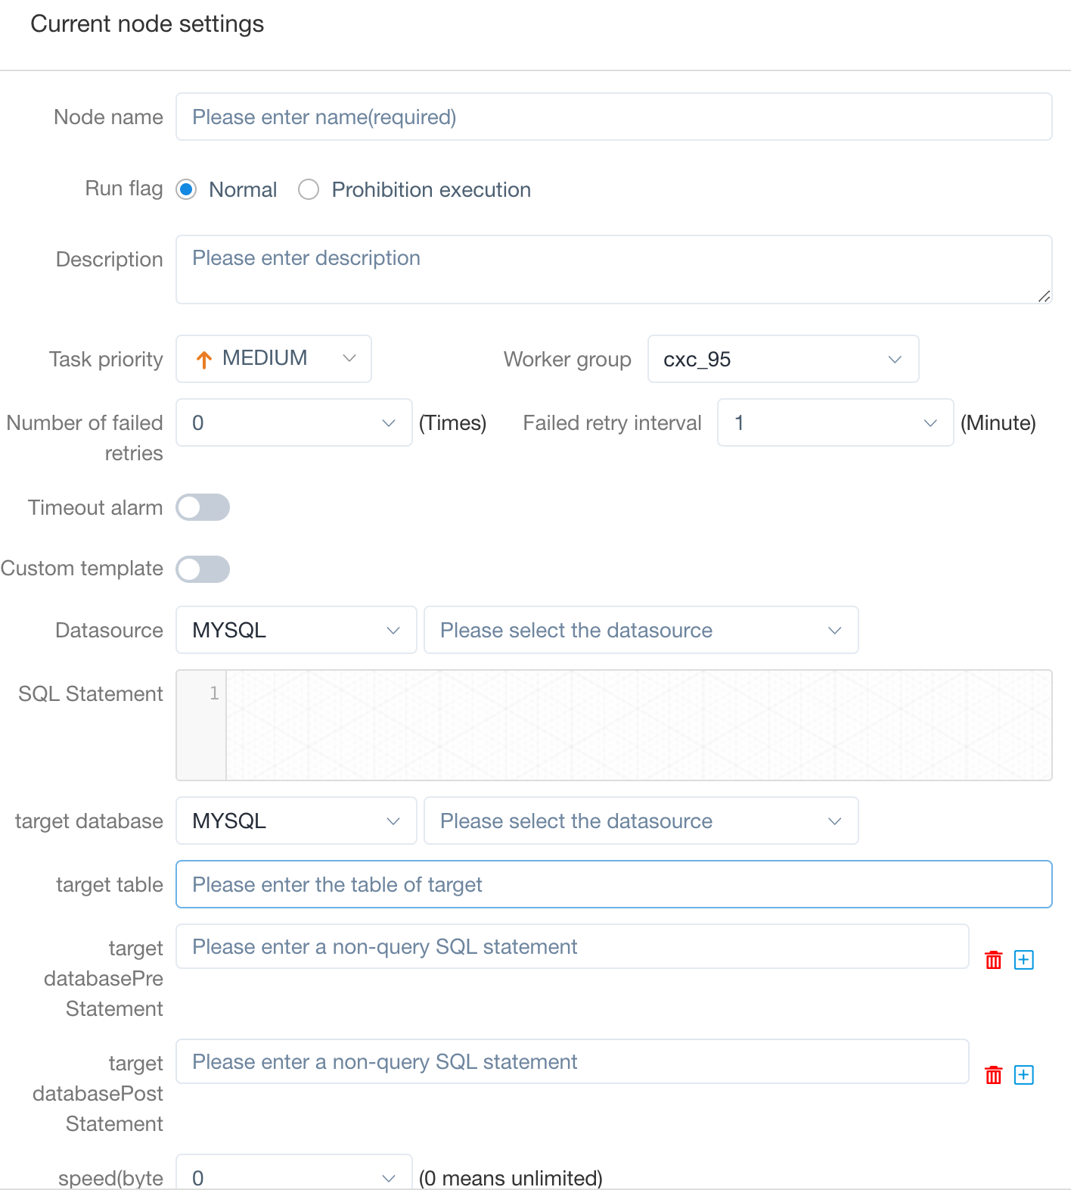
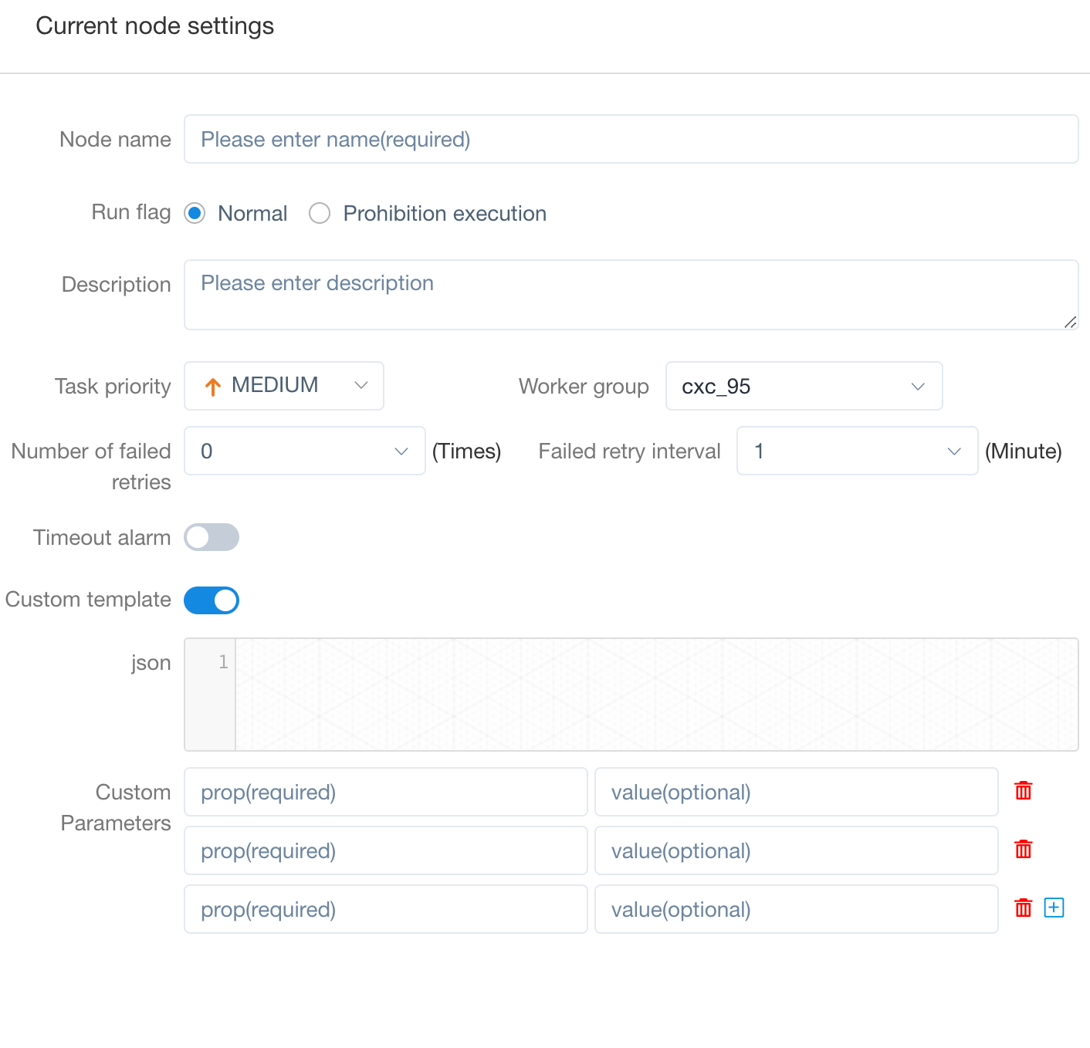

DolphinScheduler 1.3.x New Feature – Datax
Customized Template

Slide 21
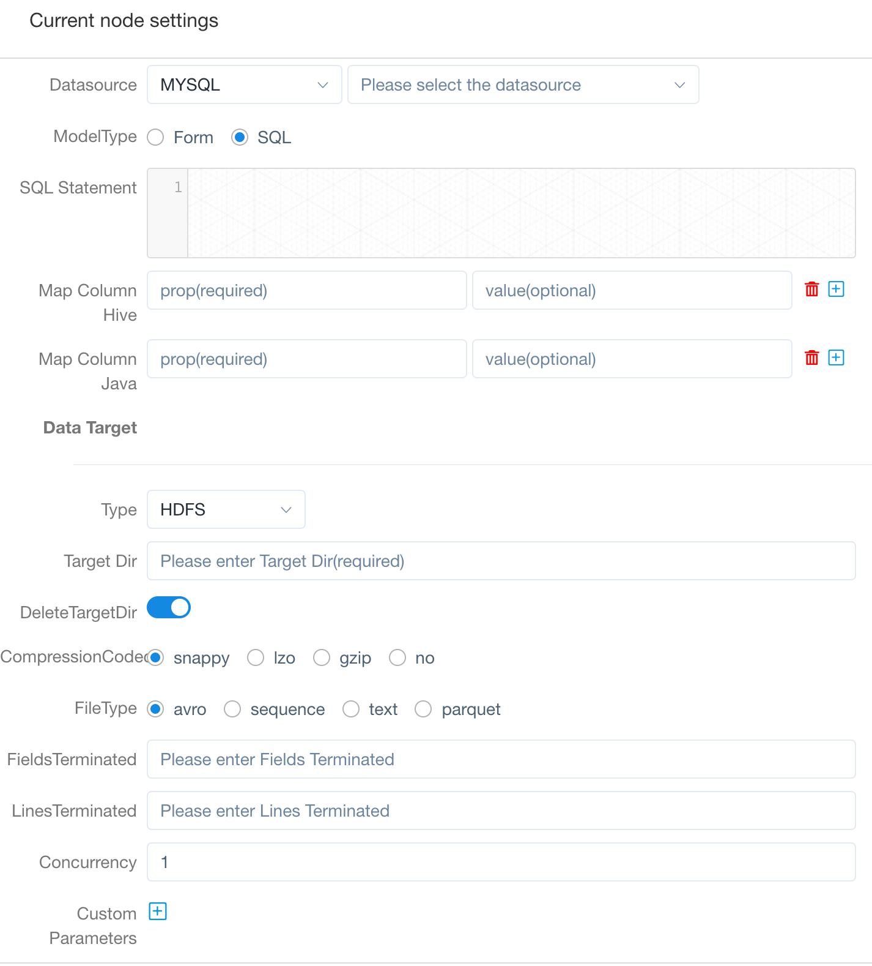

DolphinScheduler 1.3.x New Feature – Sqoop

Slide 22

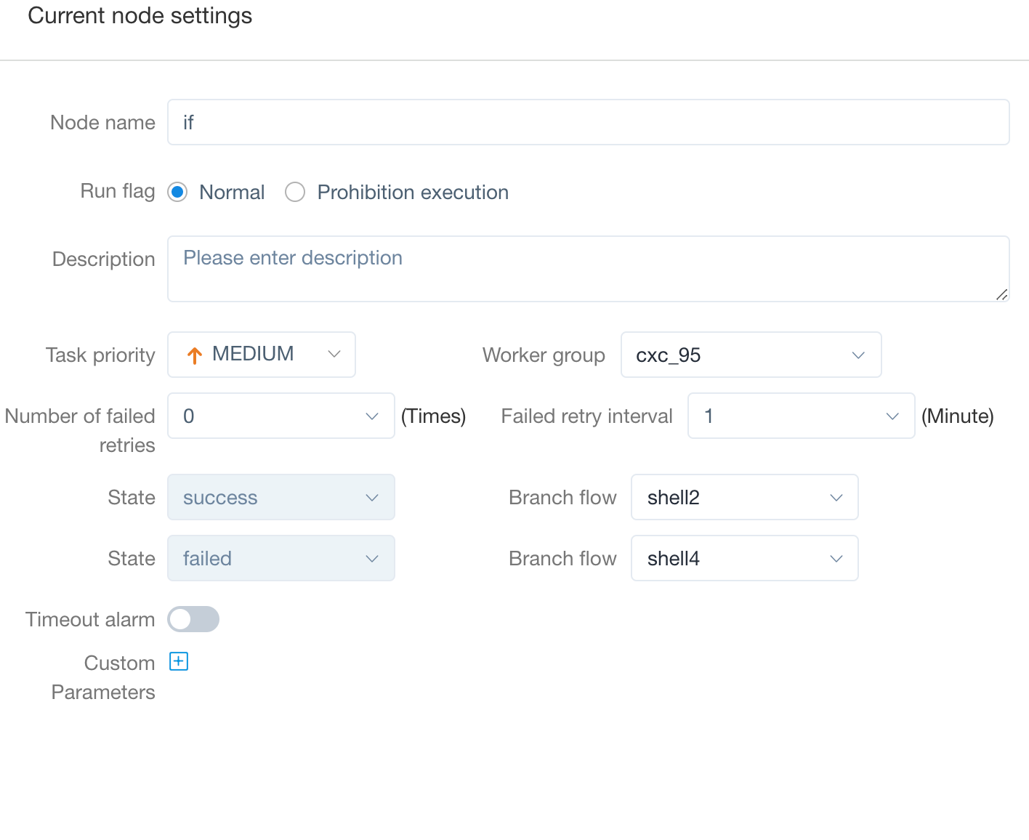
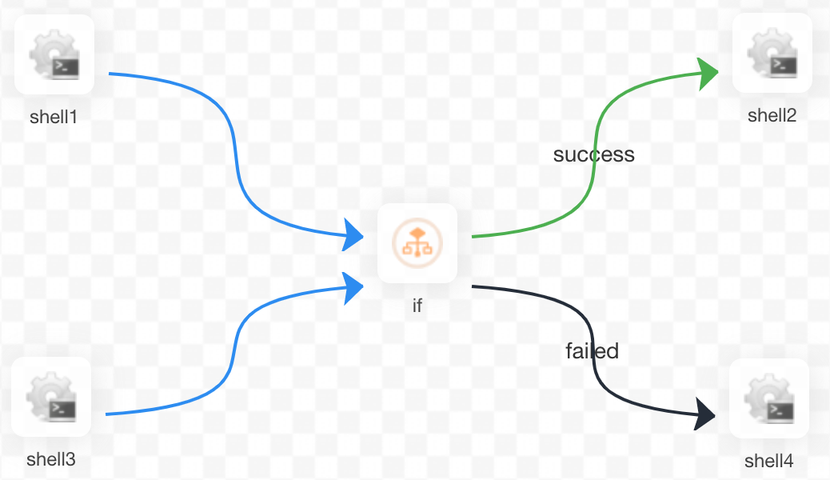
DolphinScheduler 1.3.x New Feature – Condition Task

Slide 23
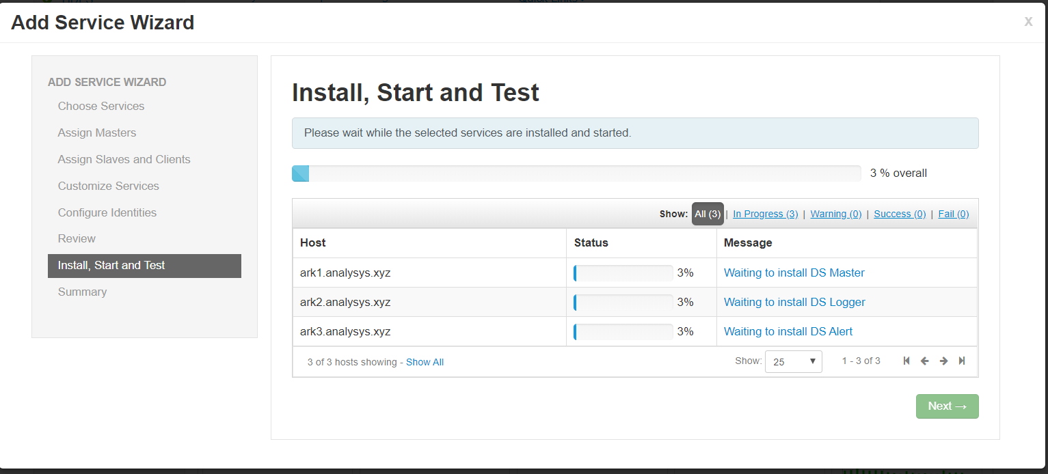
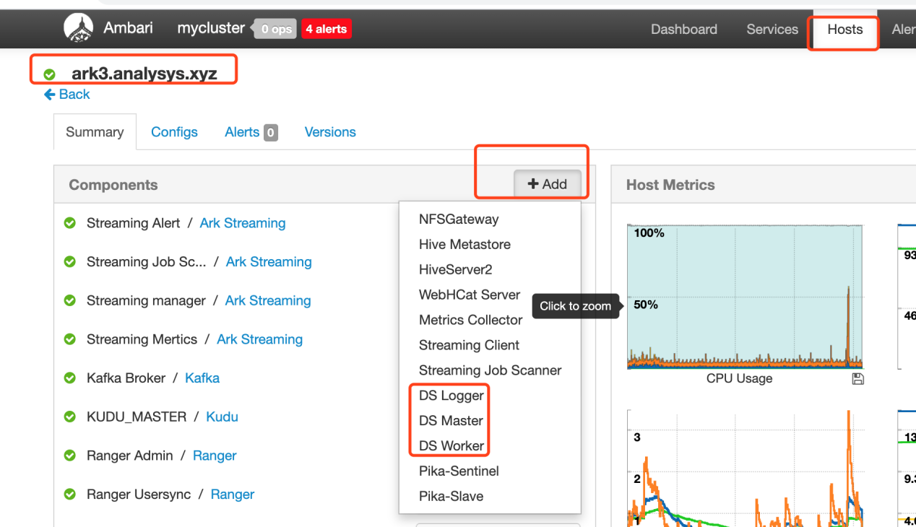
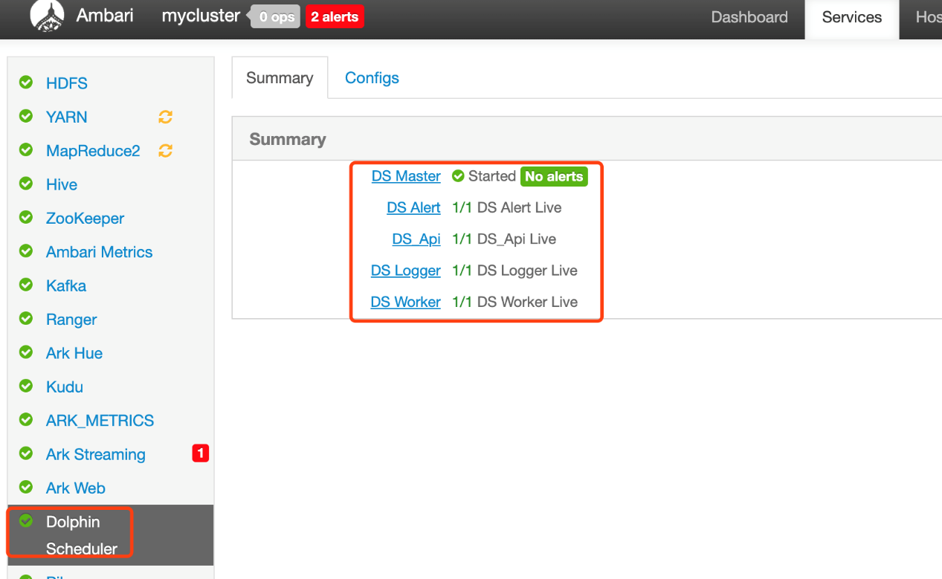
DolphinScheduler 1.3.x New Feature – Ambari Plugin

Slide 24
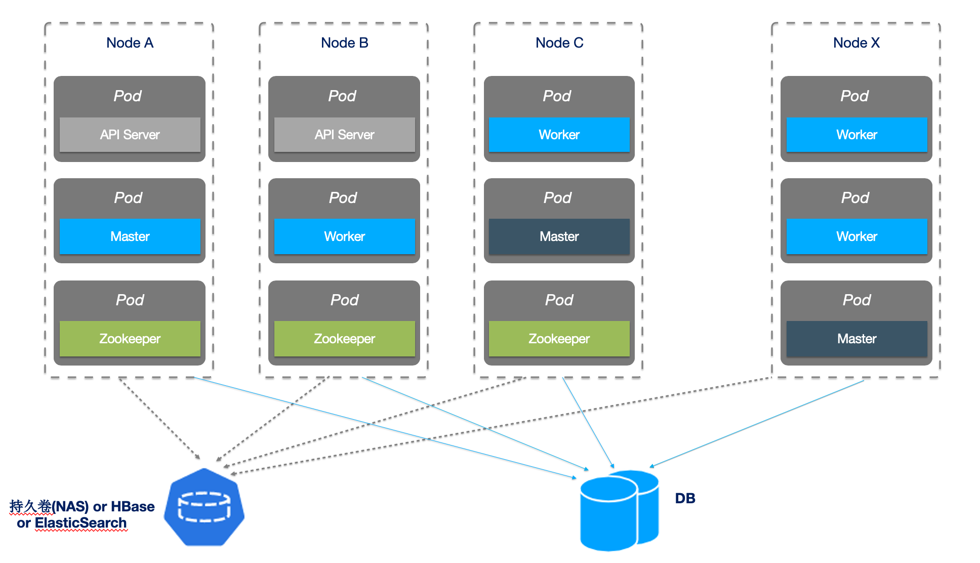
DolphinScheduler 1.3.x New Feature – K8S Support
Cloud Native is the trending
Advantages:
Elastic scaling
Make full use of server resources
Environmental isolation
Disadvantages:
Requires K8S maintenance experience

Slide 25
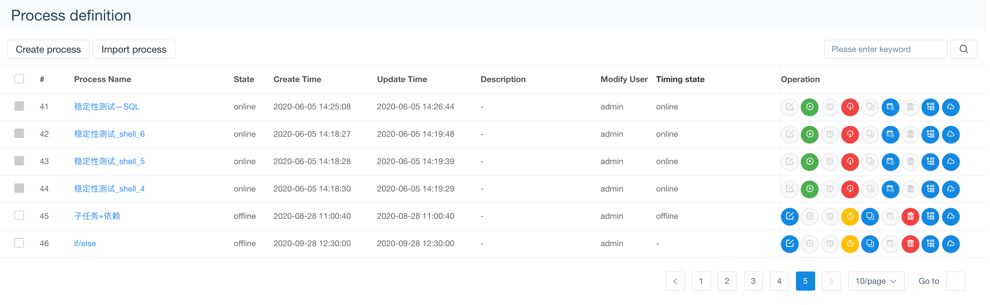
DolphinScheduler 1.3.x Other New Features
Batch import and export workflow
Process definition clone
Deletion of process instance & cascade delete task logs
Simplify configurations and optimize deployment experience

Slide 26
PART 5
Architecture Iteration
2021/4/14
26

Slide 27
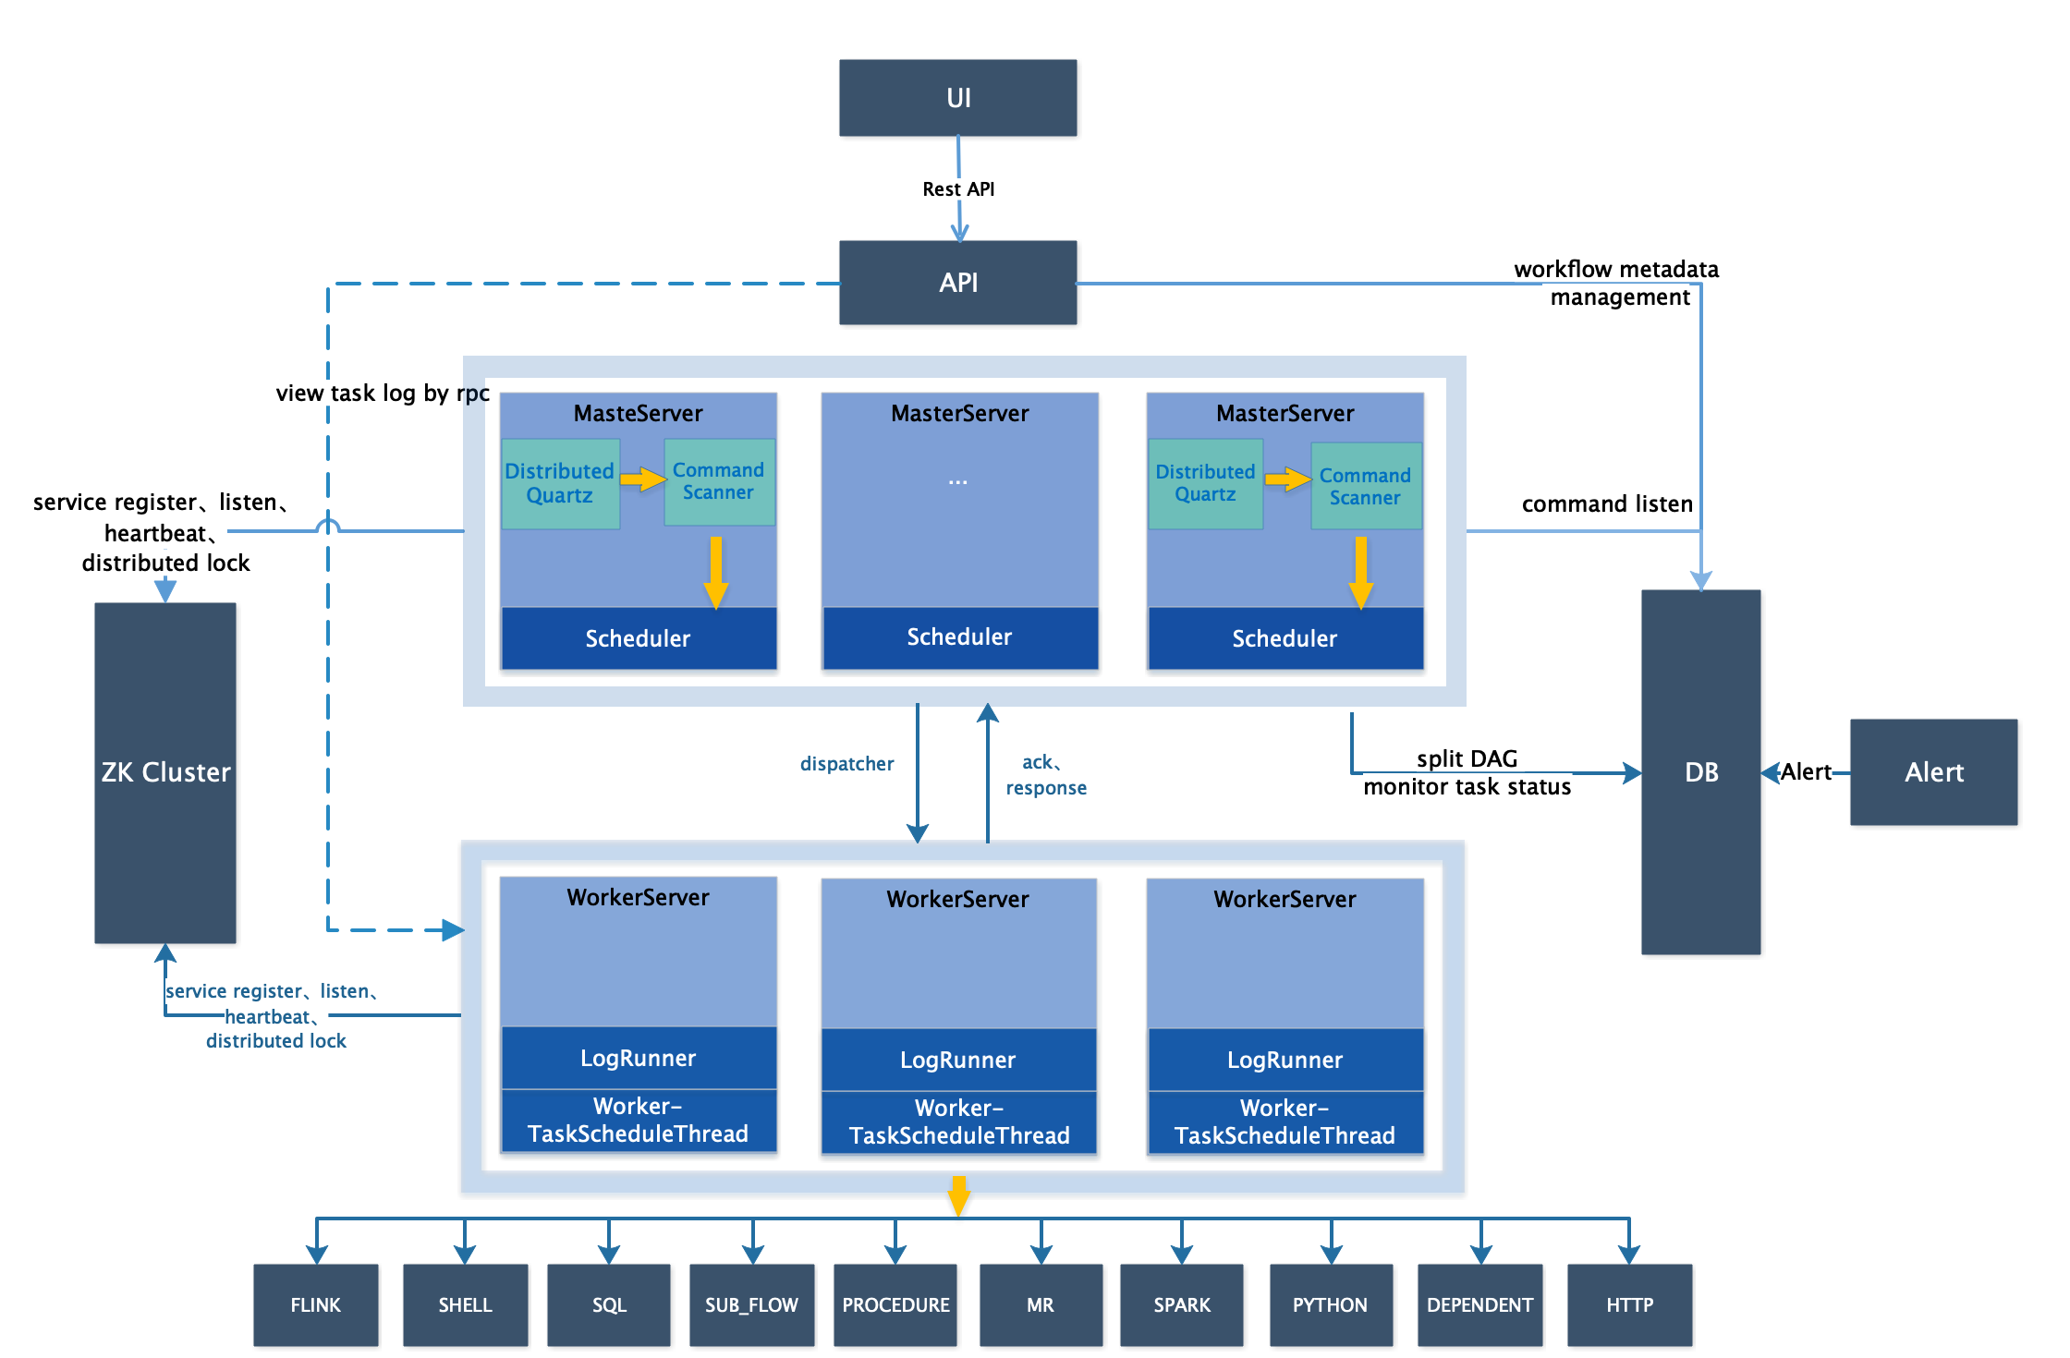
DolphinScheduler 1.3.x New Architecture
Reduce the pressure on the databases
Worker straight operate DBs, single responsibility
Master and Worker communicate directly to reduce latency
Master multi strategies to distribute tasks
- Workers load-balancing strategies:
Random, round-robin and linear maximum base on CPU & Memory

Slide 28
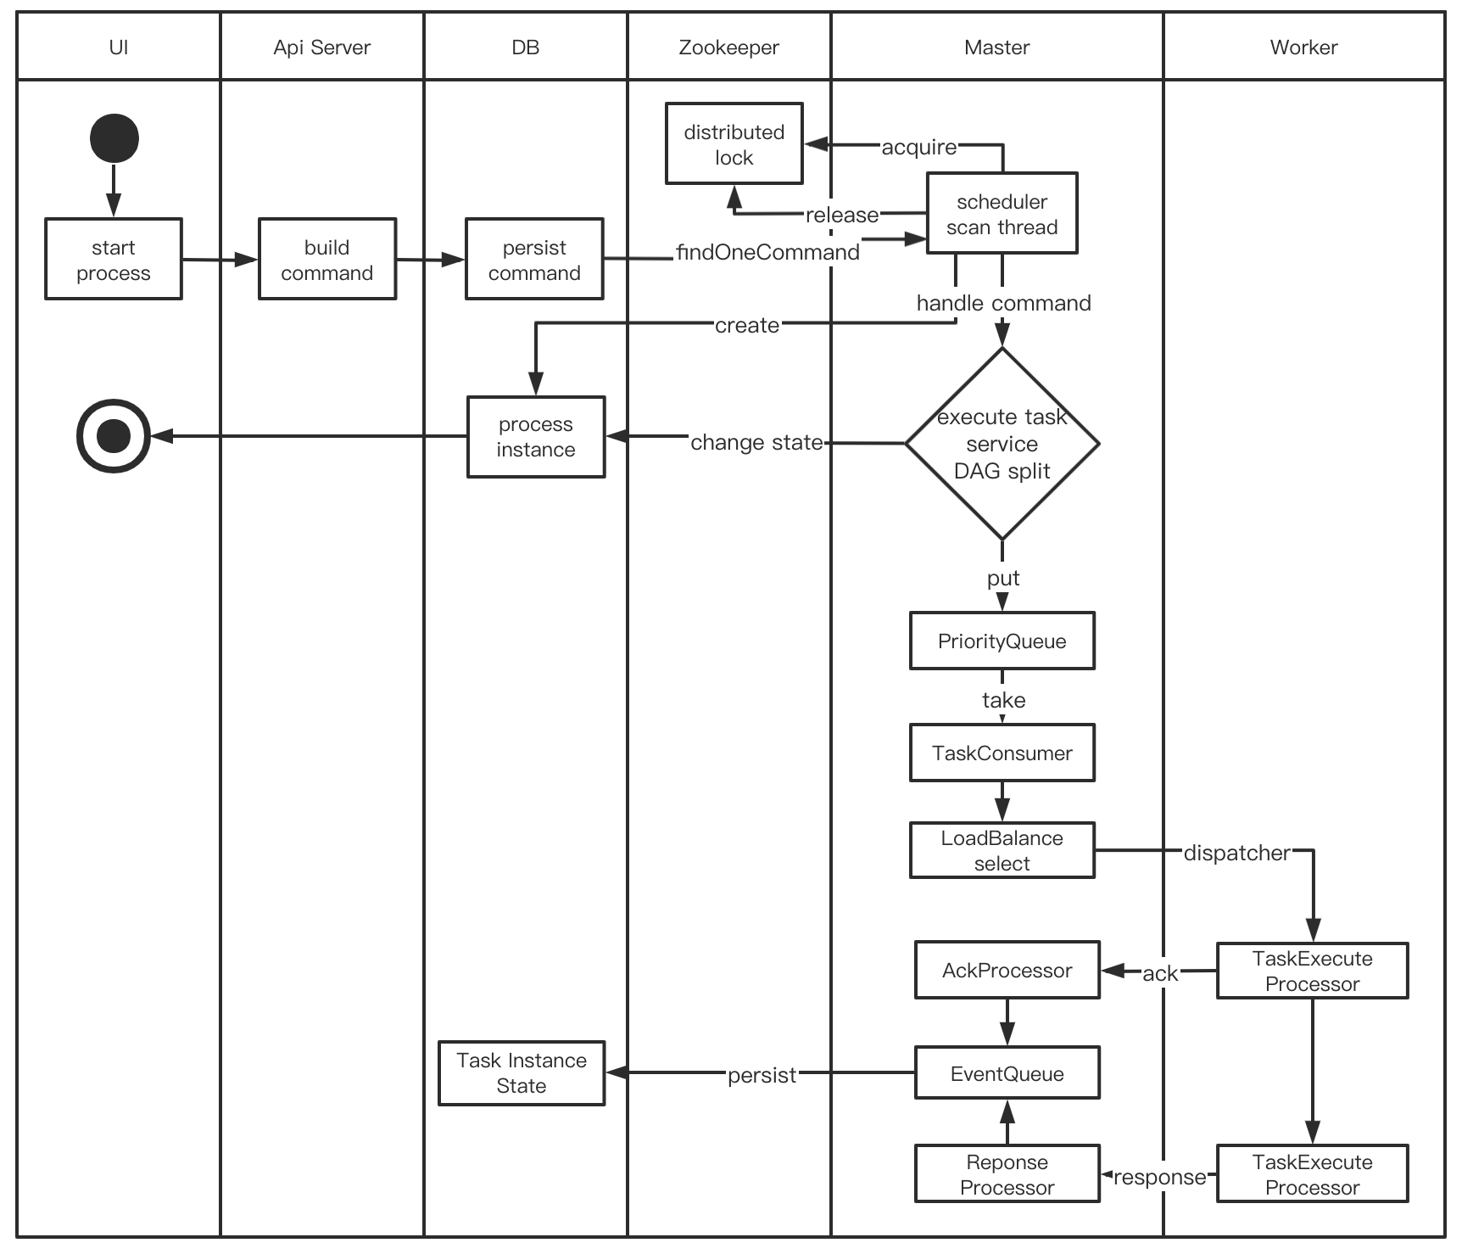
DolphinScheduler 1.3.x Workflow Activity Diagram

Slide 29
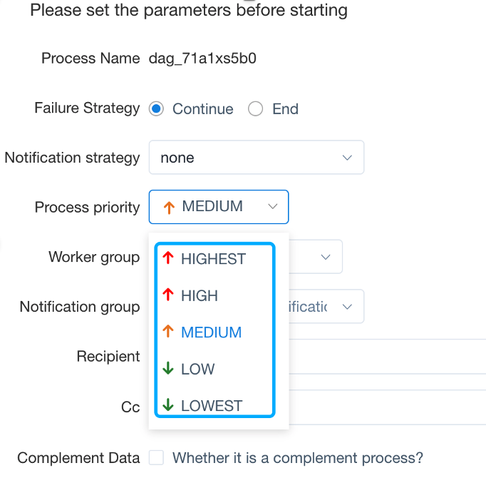
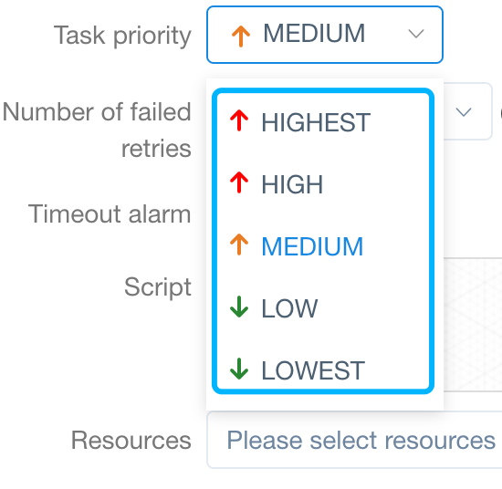
Experience: About Task Priority
Question：
Solution：
There's no priority design and fair scheduling design in early stage:
The task submitted first may be completed at the same time with the later
Low-priority services run first, occupying and not releasing resources
Different process priorities > process instance sequence > task instance priority > task instance sequence
Default: FIFO

Slide 30
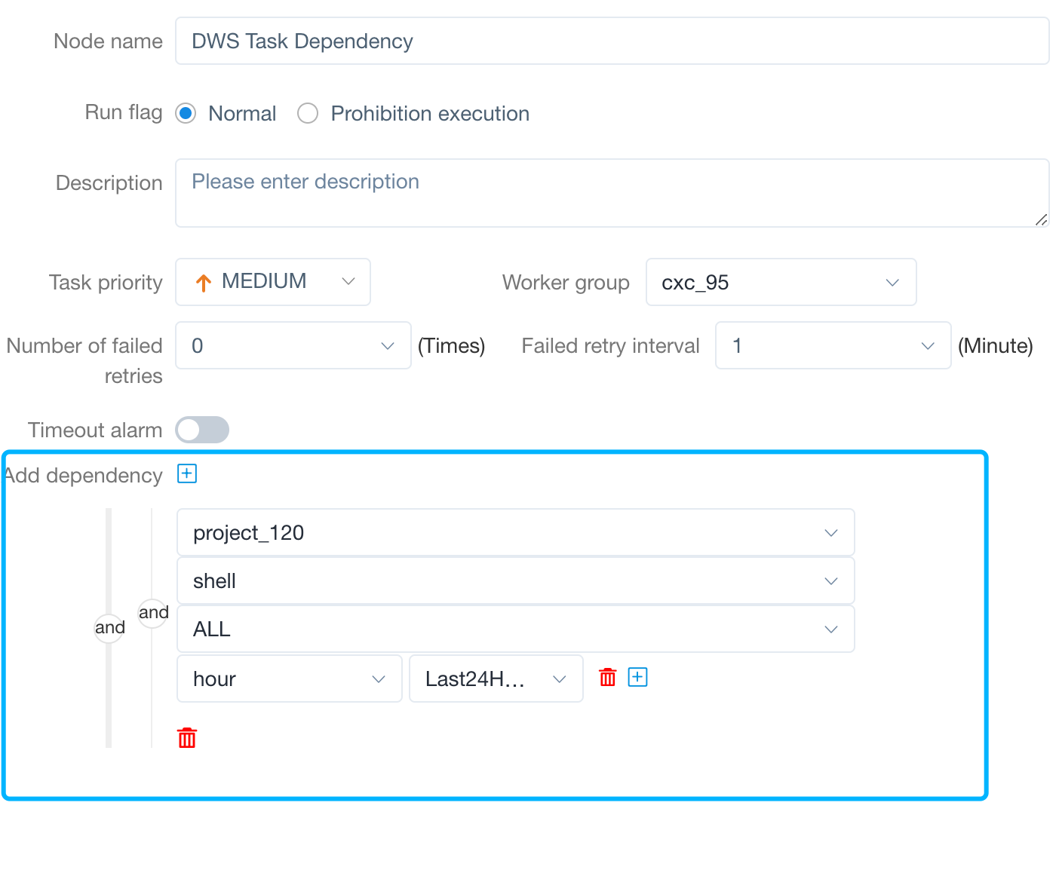
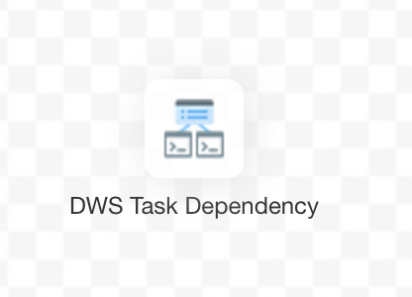
Experience: About Task Dependency
Task dependency, literally all about the task dependency check
For example: If day process A depends on hour process B last day, A will check the result of B before execution

Slide 31
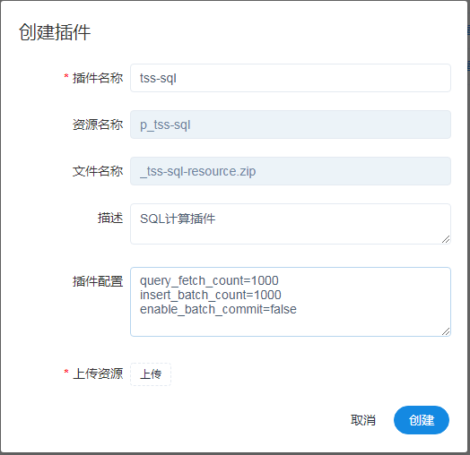
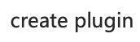
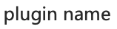
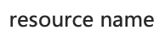
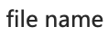
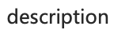
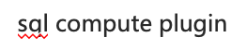
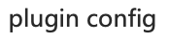


Experience: About Data Component Integration
Currently, over 10 task types may not meet the business demand
Solution：
Task plugin
Hot pluggable
data receive
data develop
data quality
data sync task
SQL task
data quality
kettle task
procedure task
...
business task

Slide 32
PART 6
Use cases
2021/4/14
32

Slide 33
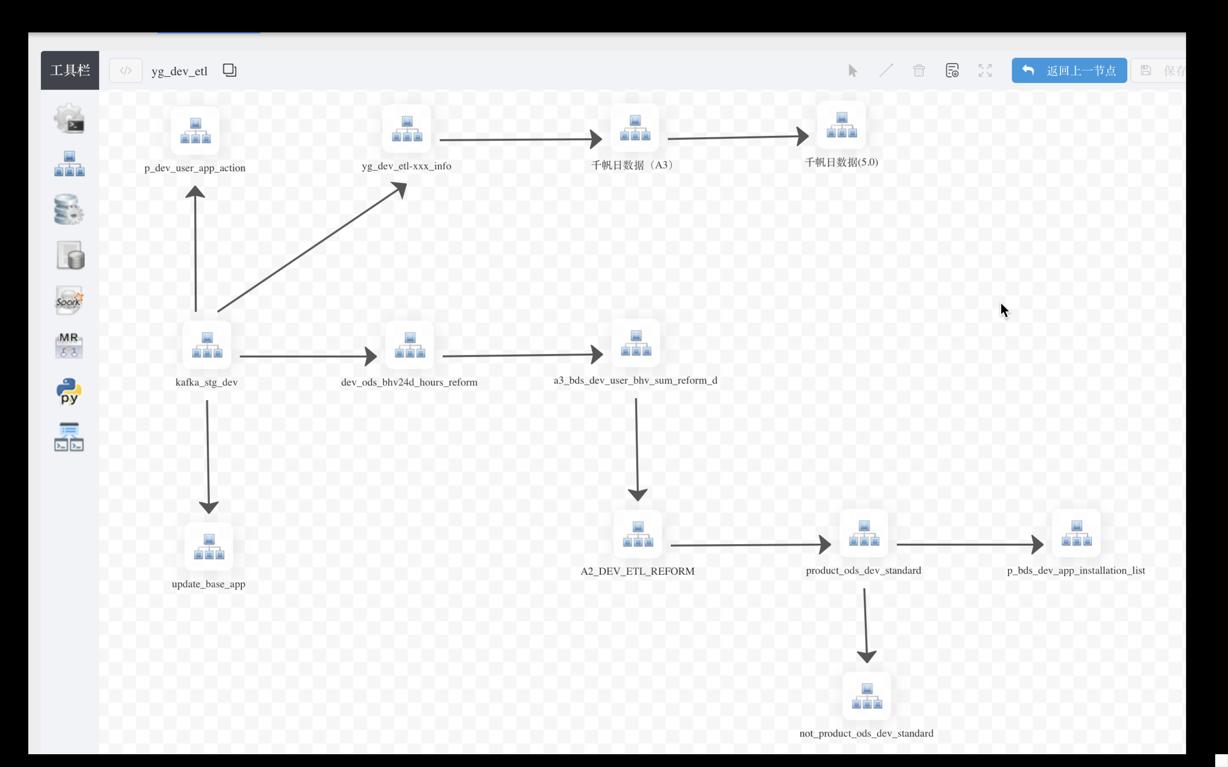
Practice of DolphinScheduler in Analysys
Analysys Qianfan is a benchmarking analysis App.
Qianfan is a SaaS service app that needs to process tens of billions of data each day, 620 million MAU, and process 6.8 PB of big data through tens of thousands of ETL tasks processing every day.
In 2018, we started to use DolphinScheduler to schedule the entire ETL process.
The picture on the right is one of the workflows

Slide 34
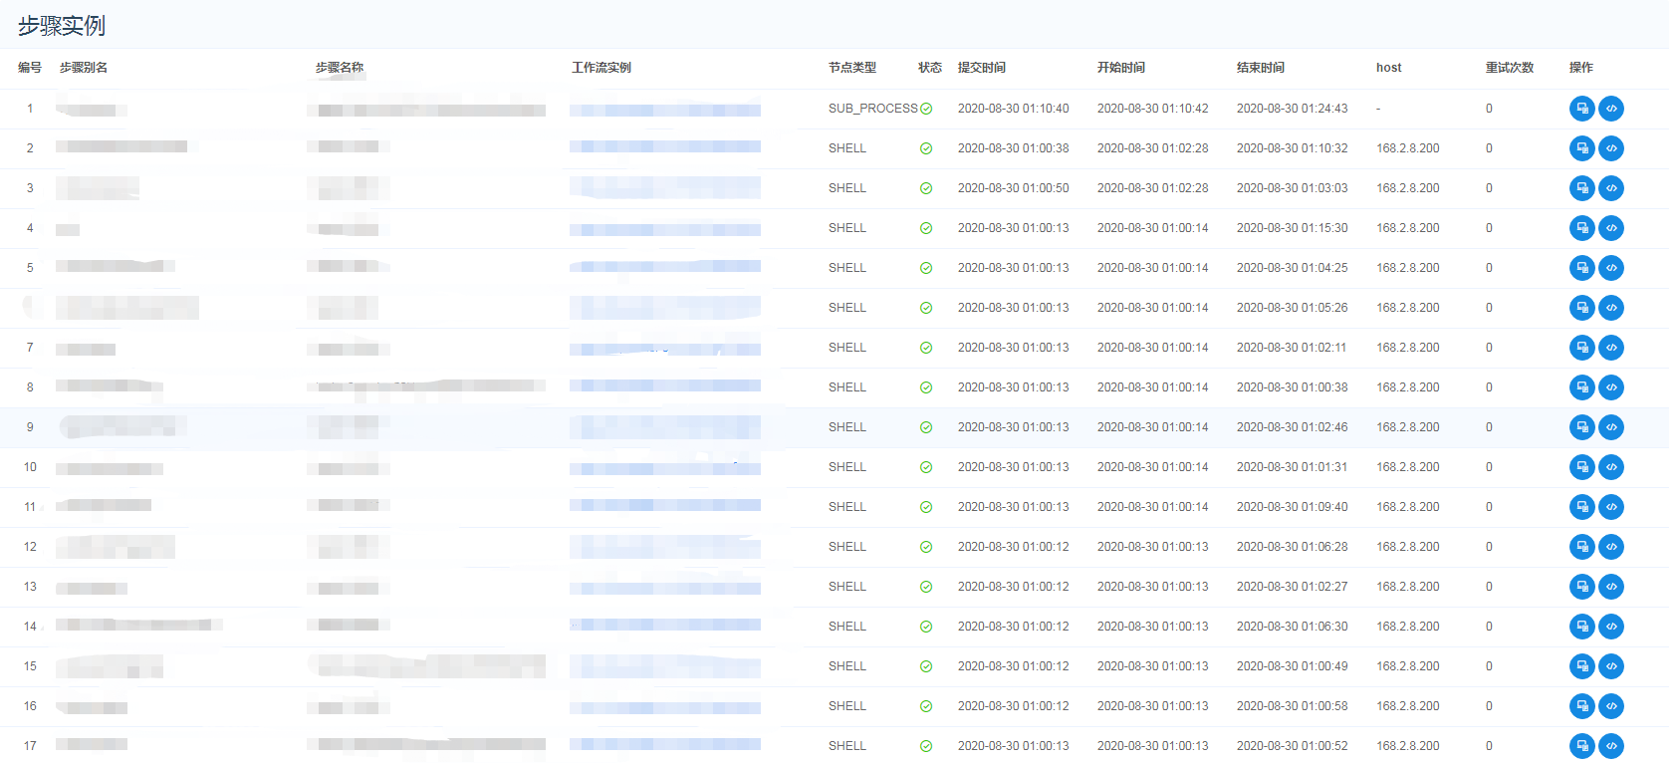
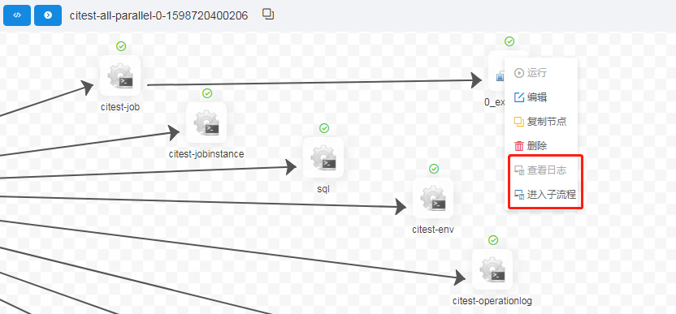
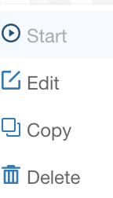


Practice of DolphinScheduler in Baosight xIn3Plat
Extensions implemented by Baosight:
Plugin type task
Resource cache
SQL function extension
Message triggered scheduling
Multiple data source access
Workflow concurrency control
Operation audit
Alert optimization
Configuration management
Authorization control
Operational data archiving

Slide 35
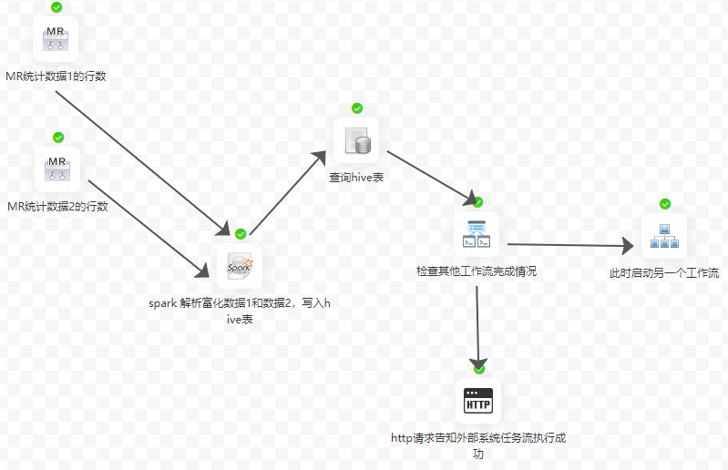
Practice of DolphinScheduler in Qianxin
Task failure retry/alert
retry times? interval? email?
Complex scheduling
5
Online resource files management
cron、dependent、manual
scheduling
4
6
don't worry about losing the jars
Cluster high availability
Multi task types
3
7
spark、shell、mr、hive python…
decentralization
Workflow
Visualization
2
8
Support multi-tenant
drag and drop to generate DAG
Different rols can't use the same account
1
9
Authorization management
Distributed & easy to extend
can only access authorized projects and resources
no single node issues
extend if insufficient resources
Why DolphinScheduler ？

Slide 36
PART 7
Future Roadmap
2021/4/14
36

Slide 37
DolphinScheduler Roadmap Draft
Overall, arrange product demands priorities according to the community demands and attentions and make decisions via community email discussion
Master refactor: create api communication with master, event-driven, etc.
Task parameter transfer
Task type Plugins (doing)
Concurrency control of tasks
Workflow triggers
Data quality
List dependency (upstream dependency)
Support multi-cluster deployment release
Workflow version management
Authorization redesign
Easier to use
If you have more suggestions for the Roadmap, please disscuss in dev mailing list

Slide 38

Open-Source History Milestones
DolphinScheduler Architecture design
Decided to Open Source Cost 2 months refactoring
Release Versions 1.0.1、1.0.2、1.0.3
First Apache Version 1.2.0
1.3.5
2017.12
2019.02
2019.05
2019.12
…
2018.05
2019.03
2019.08
Internal Use Qianfan product implementation
External Seed Users Officially open sourced on March 30th - v1.0.0
Enter Apache Incubator

Slide 39


DolphinScheduler Slogan
Choose Good Tools
Back Home Early
SUCCESS
z
Use Right
Scheduler
Sleep Tight
z
z
z
z
z

Slide 40
PART 8
Related Resources
2021/4/14
40

Slide 41
DolphinScheduler Resources
Online DEMO: http://106.75.43.194:8888/
Website：https://dolphinscheduler.apache.org
Github ： https://github.com/apache/incubator-dolphinscheduler
Welcome to join the community. Joining the Open-Source community starts from submitting the first PR.
- Try to find the “easy to fix” tags or some very easy issue, fix and submit a PR
Get Help:
Submit an issue
Mail to dev-subscribe@dolphinscheduler.apache.org, follow the reply to subscribe the mail list.

